Slide 1


CAPSTONE PROJECT
African American achievements
Presented By:
1. R.Rajeshwarma-Solamalai College of Engineering-Mechanical Engineering

Slide 2
OUTLINE
○
Probelm Statement
Proposed Solution
System Approach
Algorithm & Deployment
Result
Conclusion
Future Scope
References
○ ○ ○ ○
○
○ ○

Slide 3
PROBLEM STATEMENT
The problem lies in the underrepresentation, lack of recognition, and systemic barriers hindering African American achievements across various sectors.

Slide 4
PROPOSED SOLUTION
Celebrate African American achievements through education, media representation, workplace diversity, and public recognition.

Slide 5
SYSTEM APPROACH
Building the proposed solution would involve a combination of data processing,feature engineering,and machine learning. Here are the key system and library requriements.
System Requirements:
1.Hardaware:
A computer with sufficent processing power,perferably wwith multiple cores or a GPU for faster traning of machine learning models.
Adequate RAm to handke the size of the saraset and computational requriments.
2. Software:
An operating syatem compatible with the requrired machine learning libraries(eg., Windowa=s, linux,macsOS).

Slide 6
ALGORITHM & DEPLOYMENT
K-Nearest Neighbors (KNN) algorithm
The K-Nearest Neighbors (KNN) algorithm is a popular machine learning technique used for classification and regression tasks. It relies on the idea that similar data points tend to have similar labels or values. During the training phase, the KNN algorithm stores the entire training dataset as a reference.
Steps to implement the K-NN algorithm:
Data Pre-processing step
Fitting the K-NN algorithm to the Training set
Predicting the test result
Test accuracy of the result(Creation of Confusion matrix)
Visualizing the test set result.

Slide 7
ALGORITHM & DEPLOYMENT
Deep neural networks (DNN)
Deep neural networks (DNN) is a class of machine learning algorithms similar to the artificial neural network and aims to mimic the information processing of the brain.
Steps to implement the DNN algorithm:
Data collection
Feature extraction
Information processing
Model training
Performance evaluation

Slide 8
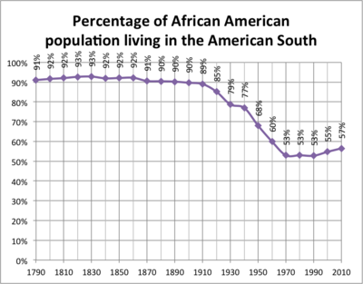
RESULT

Slide 9
CONCLUSION
African American achievements are numerous and impactful, spanning various fields such as civil rights, politics, science, literature, arts, and sports. Their contributions have shaped history and continue to inspire generations.

Slide 10
FUTURE SCOPE
The future holds vast potential for African American achievements across diverse fields, driven by ongoing efforts to address inequalities and promote inclusion.

Slide 11
REFERENCES
https://www.kaggle.com/datasets/afumetto/3dprinter

Slide 12
THANK YOU

